Slide 1
Understanding Pictograph with Facial Features： End-to-End Sentence-level Lip Reading of Chinese
Xiaobing Zhang, Haigang Gong, Xili Dai, Fan Yang, Nianbo Liu, Ming Liu University of Electronic Science and Technology of China

Slide 2
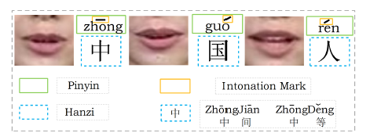
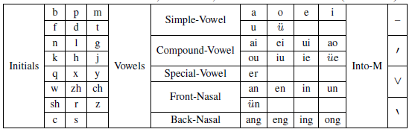
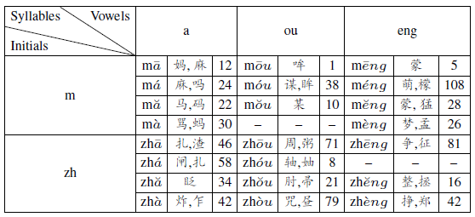
Characteristics of Chinese
Initial(23): used in front of the vowel as consonant
Vowel(24): composed of head-vowel, nuclei and tail-vowel
Intonation mark(4):
Pinyin:
Syllable: each individual Hanzi is an independent syllable symbol

Slide 3
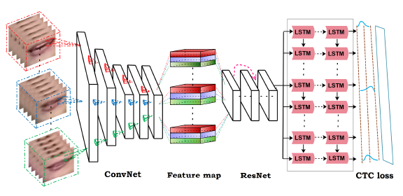


LipCH-Net
Picture-to-Pinyin model
ConvNet: based on VGG-M, capture short-dynamic of the lip region
ResNet: modified to 14-layer, facilitate information propagation
LSTMs: 2-layer, absorb the features generated from ResNet
CTC: automatically segment pictures and Pinyin sequences

Slide 4
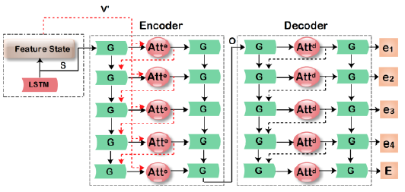




LipCH-Net
Pinyin-to-Hanzi model
Encoder: input and labels are both Pinyin sequence
works when given the feature vectors and state vector
Decoder: input and labels are both Hanzi sequence
$Attention^{e}$
$${\text{V}}^{′}$$
S
$Attention^{d}$ works as follows:

Slide 5
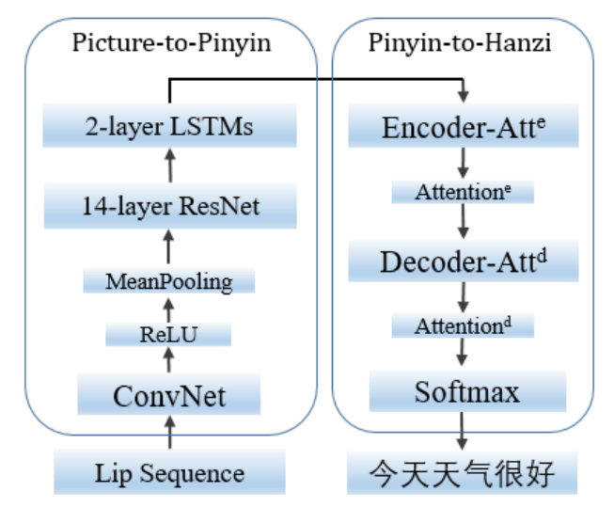

LipCH-Net
Two key components:
CTC loss in the Picture-to-Pinyin part is removed
Picture-to-Pinyin
Pinyin-to-Hanzi
$Attention^{e}$ work

Slide 6
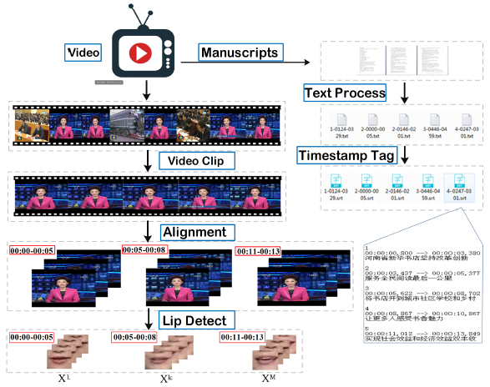
Chinese Dataset
The semi-automatic pipeline of labeling the dataset
Video clip: compare color histograms, CORELX9
Text processing: download manuscripts, segment sentences
Timestamp Tag: OksrtClient
Alignment: automatically locate and map
Lip Detect: OpenCV

Slide 7
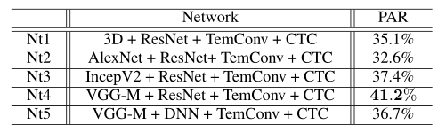
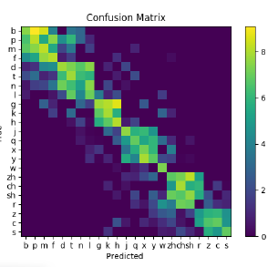
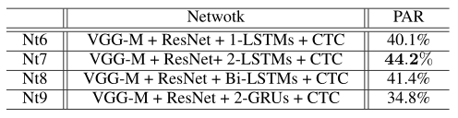
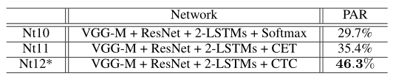
Experiment and Evaluation
Experiments of Picture-to-Pinyin
Pinyin accuracies using temporal convolution
Pinyin accuracies using different LSTMs/GRUs
Pinyin accuracies using different loss or training
Confusion matrix of initials

Slide 8
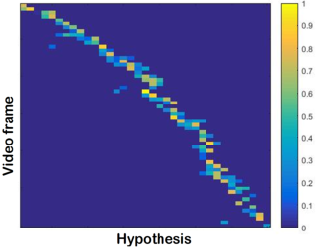
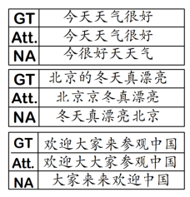
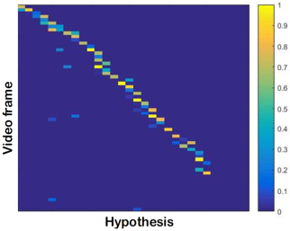
Experiment and Evaluation
Alignment between video frames and “huan ying da jia lai can guan zhong guo”
Some examples where LipCH-Net successfully deciphers
the sentences when using attention mechanism
Alignment between video frames and “欢迎大家来参观中国”

Slide 9
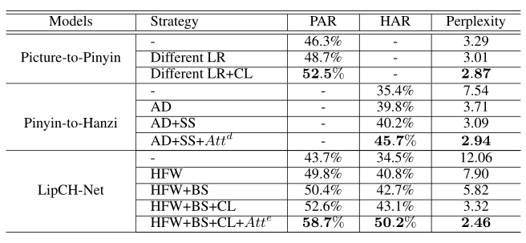
Experiment and Evaluation
Evaluate the training strategy
LR: learning rate BS: beam search
AD: auxiliary data HAR: Hanzi accuracy
SS: scheduled sampling PAR: Pinyin accuracy
CL: curriculum learning HFW: high frequency words

Slide 10
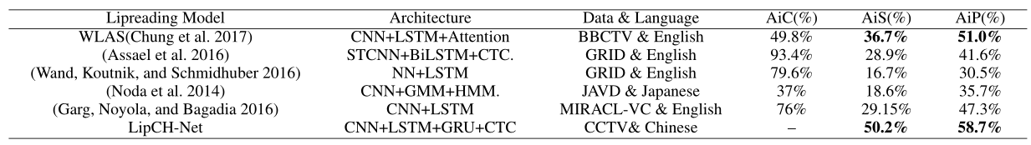
Experiment and Evaluation
Comparison work

Slide 11
Thank you!

